Slide 1
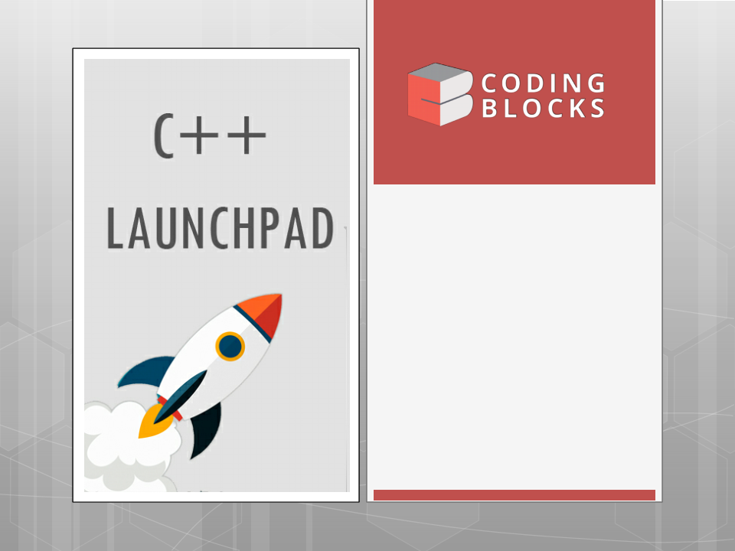
Lecture-14
Data Structures
•
Stacks
Queues
•
Kartik Mathur

Slide 2

2
Header Files

Slide 3

3
Recursion and Pile of Books

Slide 4
4
Stacks

Slide 5
5
Templates

Slide 6
6
Stacks
class Stack{
// accessor methods
int size();
bool isEmpty();
int top();
// update methods
void push (int element);
void pop();
}

Slide 7
7
How to implement Stack Class?
1.
Arrays
Linked List
2.

Slide 8
8
Dynamic Arrays

Slide 9
9
Lets Implement Our Own
Stack Class Using a
Dynamic Array

Slide 10
10
Your Turn: Implement Stack
Class Using Linked List

Slide 11
11
Lets solve few problems
Given an expression check if
are
balanced e.g. { a + [ b+ (c + d)] + (e + f) }
1.
brackets
2.
Reverse a Stack
with the help of
recursion(stack)
3.
Redudant
/Duplicate
Paranthesis
[((a+b)) + (c*d)]

Slide 12
12
Queues

Slide 13
13
Queue
class Queue{
// accessor methods
int size();
bool isEmpty();
int front();
// update methods
void enqueue(int element);
int dequeue();
}

Slide 14
14
How to implement Queue Class?
1.
Linked List
Arrays
2.

Slide 15
15
Lets Implement Our Own
Queue Class Using Arrays

Slide 16
16
Your Turn: Implement
Queue Class Using Linked
List

Slide 17
17
Lets solve few problems
1.
Reverse a Queue (Recursively)
Reverse a
2.
Queue
Implement a Stack
Implement a Stack
3.
using Two Queues
using Single Queue
4.

Slide 18
Thank You!
18
Kartik Mathur

